Slide 1
Washtenaw Association for Community Advocacy (ACA)
Opening Doors to Inclusion
Kathy Homan, President/CEO

Slide 2
Washtenaw Association for Community Advocacy
Our Mission - TO EMPOWER PEOPLE WITH INTELLECTUAL & DEVELOPMENTAL DISABILITIES TO PARTICIPATE FULLY IN COMMUNITY LIFE.
Washtenaw ACA is a 501(c)(3) organization
We are a chapter of
The Arc of TheUnited States, Inc., And an affiliate of The Arc Michigan.

Slide 3
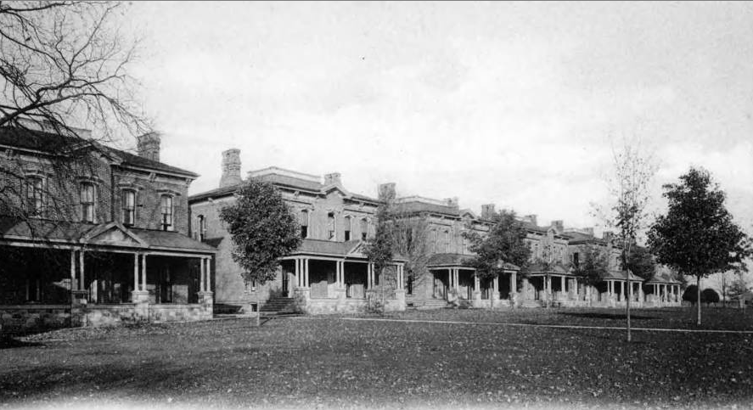
Grassroots Beginnings
ACA began as a grassroots organization established in 1949 by a group of parents whose children resided in Coldwater State Home and Training School.
1939 - Children with more serious handicaps
1960 – 2900 residents
1970 – special education, training, and living in communities becomes popular – 700 residents
Closed in 1992
Currently – Lakeland Correctional Facility

Slide 4
Advocacy Organization for People With Intellectual/Developmental Disabilities (I/DD)
Michigan definition of developmental disability
Mental Health Code (Excerpt)
Act 258 of 1974
(26) "Developmental disability" means either of the following:
(a) If applied to an individual older than 5 years of age, a severe, chronic condition that meets all of the following requirements:
(i) Is attributable to a mental or physical impairment or a combination of mental and physical impairments.
(ii) Is manifested before the individual is 22 years old.
(iii) Is likely to continue indefinitely.
(iv) Results in substantial functional limitations in 3 or more of the following areas of major life activity:
(A) Self-care.
(B) Receptive and expressive language.
(C) Learning.
(D) Mobility.
(E) Self-direction.
(F) Capacity for independent living.
(G) Economic self-sufficiency.
(v) Reflects the individual's need for a combination and sequence of special, interdisciplinary, or generic care, treatment, or other services that are of lifelong or extended duration and are individually planned and coordinated.
(b) If applied to a minor from birth to 5 years of age, a substantial developmental delay or a specific congenital or acquired condition with a high probability of resulting in developmental disability as defined in subdivision (a) if services are not provided.
MCL 330.1100a Definitions; A to E

Slide 5
Advocacy Organization for People With Intellectual/Developmental Disabilities
Cerebral Palsy
Deaf
Down Syndrome
Angelman Syndrome
Cognitive Impairment
ADHD Attention-deficit/hyperactivity disorder
Blind
Intellectual Disability
Fragile X
Autism
Language Disorders
Fetal Alcohol Spectrum Disorders

Slide 6
Advocacy Organization for PEOPLE With Intellectual/Developmental Disabilities
Presume Competence
Human Rights
Civil Rights
The Dignity to Fail
Nothing About Me Without Me

Slide 7
What We do……..
Complex Systems Navigation/Advocacy:
Social Security Administration – SSA
Department of Health and Human Services – MDHHS
Medicaid/Medicare - MA
Michigan Rehabilitation Services – MRS
Community Mental Health - CMH
Education
Special Needs Trusts – Trust Management

Slide 8
WIPA
Social Security Administration – SSA
Work Incentives Planning and Assistance Grant.
WIPA is a step by step process to assist people with disabilities, receiving benefits from Social Security, with understanding how employment will affect their Medicare, Medicaid, Supplemental Security Income (SSI), Social Security Disability Insurance (SSDI) and other benefits they may receive. WIPA also helps beneficiaries to understand how they can increase their financial independence.
Supplemental Security Income (SSI) cash benefits
Social Security Disability Insurance (SSDI) cash benefits
Medicare
Medicaid
Other Health or Disability Insurance
Unemployment Benefits
Veterans Benefits
Housing Subsidies
Food Assistance
In 2022 ACA had 311 WIPA Cases

Slide 9
Michigan Alliance for Families (MAF)
Education Advocacy – Special Education and Foster Care
Michigan Alliance for Families provides information, support, and education for families who have children (birth through 26 years of age) who receive (or may be eligible to receive) special education services. The goal is to increase the involvement of families in their children’s education.
ACA provides direct advocacy services for:
Individuals with Disabilities Education Act (IDEA):
IEP meetings – Individual Education Program
Behavior Plans
REED - Review of Existing Evaluation Data
MDR – Manifestation Determination Review
Team Meetings
ACA has 24 current cases

Slide 10
Ann Arbor Area Community Foundation
Community Mental Health Advocacy-
Washtenaw County Community Mental Health (WCCMH) is the primary community mental health provider in Washtenaw County for individuals living with serious mental illness, intellectual/developmental disability or children with a serious emotional disturbance. WCCMH is eligibility based and mandated to prioritize the needs of individuals who have Medicaid, no insurance and/or urgent or emergent needs.
ACA provides direct advocacy services for: Systems navigation
IPOS – Individual Plan of Service
Independent Facilitation - PCP/IPOS
PCP – Person Centered Planning
Waiver navigation – State waivers provide direct services for people with I/DD
Medicaid provider manual – policies for CMH
MDHHS – laws and policies
ACA has 40 current advocacy cases with CMH

Slide 11
Wayne State University
National Core Indicators
A national effort to measure and improve the performance of state developmental disabilities service systems.
In-Person Surveys
The NCI-IDD In-Person Surveys (IPS) are conversations with adults receiving case management and at least one paid service from the state.
ACA Conducted 100 surveys in 2023.

Slide 12
Fee For Service….Education Advocacy
Education Advocacy -
Fee For Service –
Fee based on sliding scale – Federal Poverty Level (FPL)
250% of FPL
10 months or 30 hours of education advocacy services
Individuals with Disabilities Education Act (IDEA):
IEP meetings – Individual Education Program
Behavior Plans
REED - Review of Existing Evaluation Data
MDR – Manifestation Determination Review
Team Meetings
ACA provides services to 10 families per year

Slide 13
Other Programs and Services….
Special Needs Trust Management
Education and Learning Series
SSI
Special Education
Alternatives to Guardianship
Social Security (SSI/SSDI)
MiAble
Estate planning
Appealing CMH decisions
Information and Referrals for I/DD support
UoM Medical Center I&R’s and partnerships
State, County, City, advocacy

Slide 14
State and Local Advocacy…..
Waskul et al v. Washtenaw County Community Mental Health et al
Plaintiffs: Derek Waskul, Cory Schneider, Kevin Wiesner, Hannah Ernst, Washtenaw Association for Community Advocacy
Defendants: Michigan Department of Health and Human Services (MDHHS), Community Mental Health Partnership of Southeast Michigan, Washtenaw County Community Mental Health, and various individuals associated with those organizations.
Summary - CLS is a medically necessary service meant to help a person participate in the community and keep their independence. Self-determination (SD) is a system where the person getting the CLS chooses and hires the staff to provide the CLS. This lawsuit claims that in 2015, Washtenaw County Community Mental Health (WCCMH) reduced the amount SD CLS recipients had in their budgets to hire those staff and participate in community life. Now, people in Washtenaw County who need CLS workers to live and maintain their independence cannot hire staff or get into the community.

Slide 15
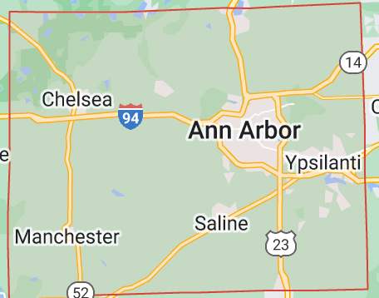
Washtenaw Association for Community Advocacy
Current Doings……
County-wide stakeholder meetings.

Slide 16
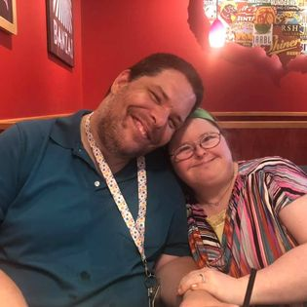
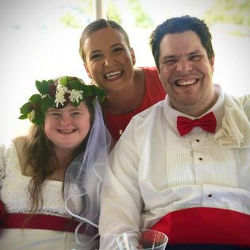
Washtenaw Association for Community Advocacy
End on a Happy Note!

Slide 17
Washtenaw Association for Community Advocacy
Thank you for your interest in ACA!

